Slide 1
Comp 2021 Project Demo: HKUST Course Analysis
Group: Trine
Member: Chan Nok Hin, Cheng Hoi Kei, Sze Ka Yu

Slide 2

Motivation
A lot of time is wasted in enrolling courses
Thus we want to improve this situation
(currently only involves COMP courses)

Slide 3



Tools
Server Side
Creating PHP
Web grabber
Generating graphs
Client Side
Creating html and JavaScript
Design webpage appearance
Database management
Relational database
Store all grabbed data

Slide 4
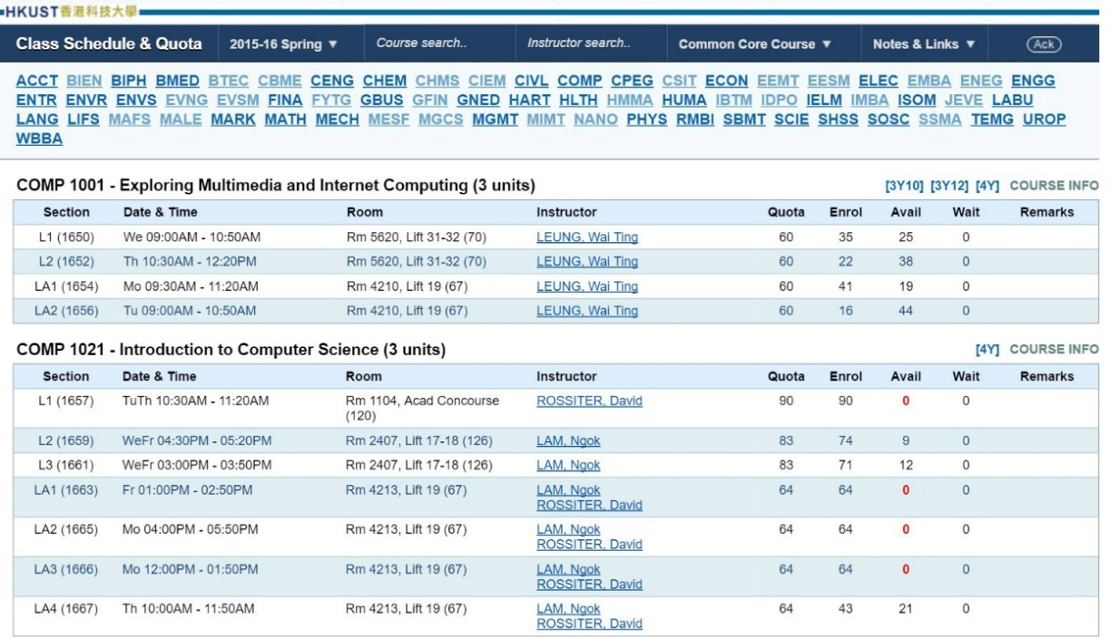
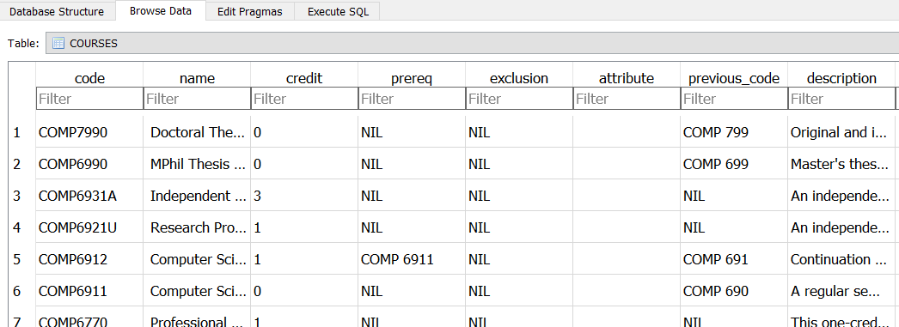
Feature – Data Grabbing
Automated Grabber Script
Obtain data from “Class Schedule & Quota”
Using DOM selector
Load data into database

Slide 5
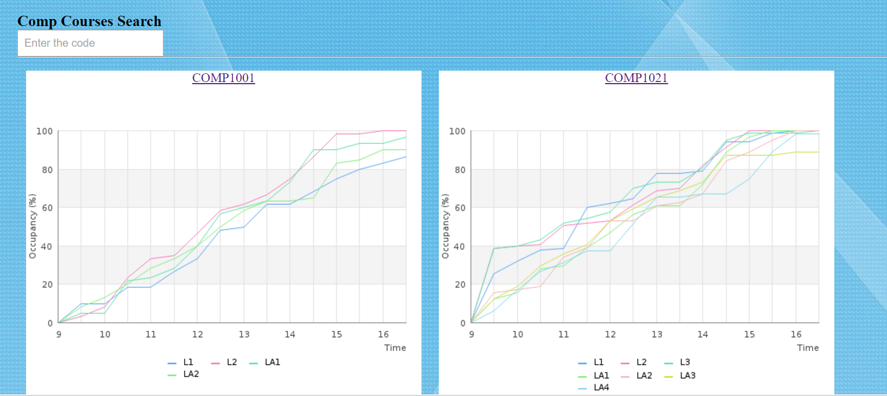
Feature – Trends
An overview of all courses
Provide filtering function

Slide 6
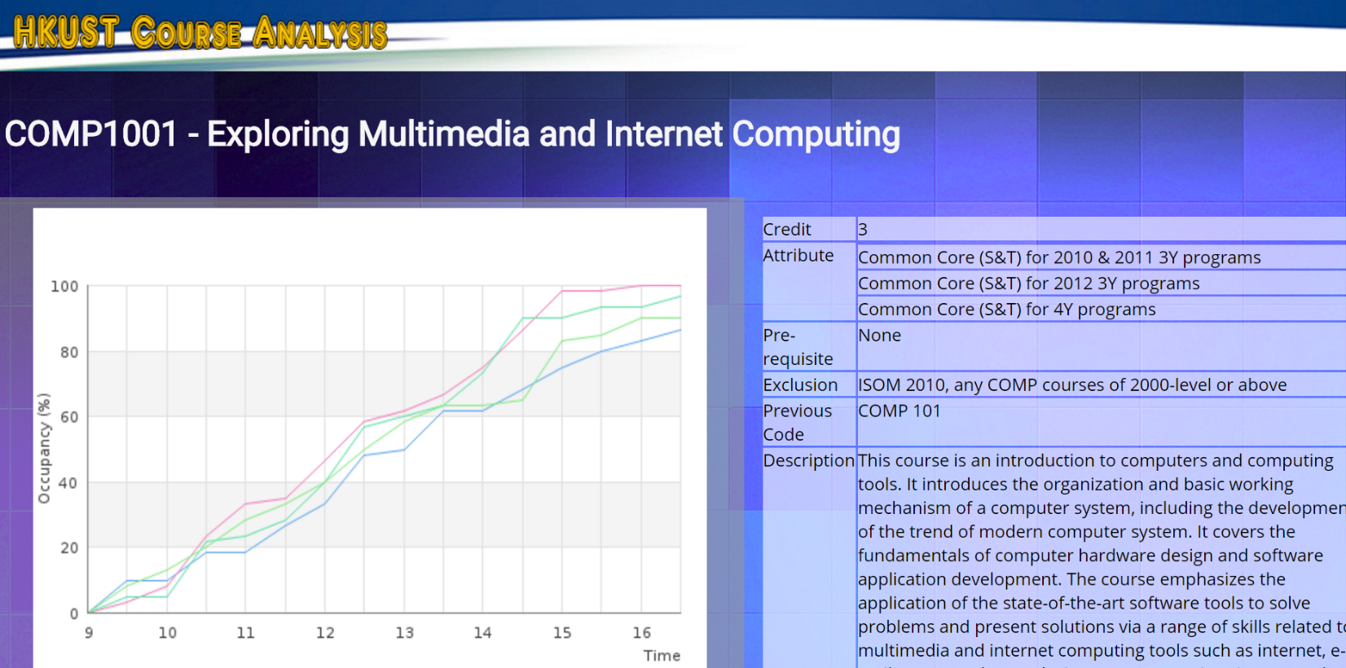
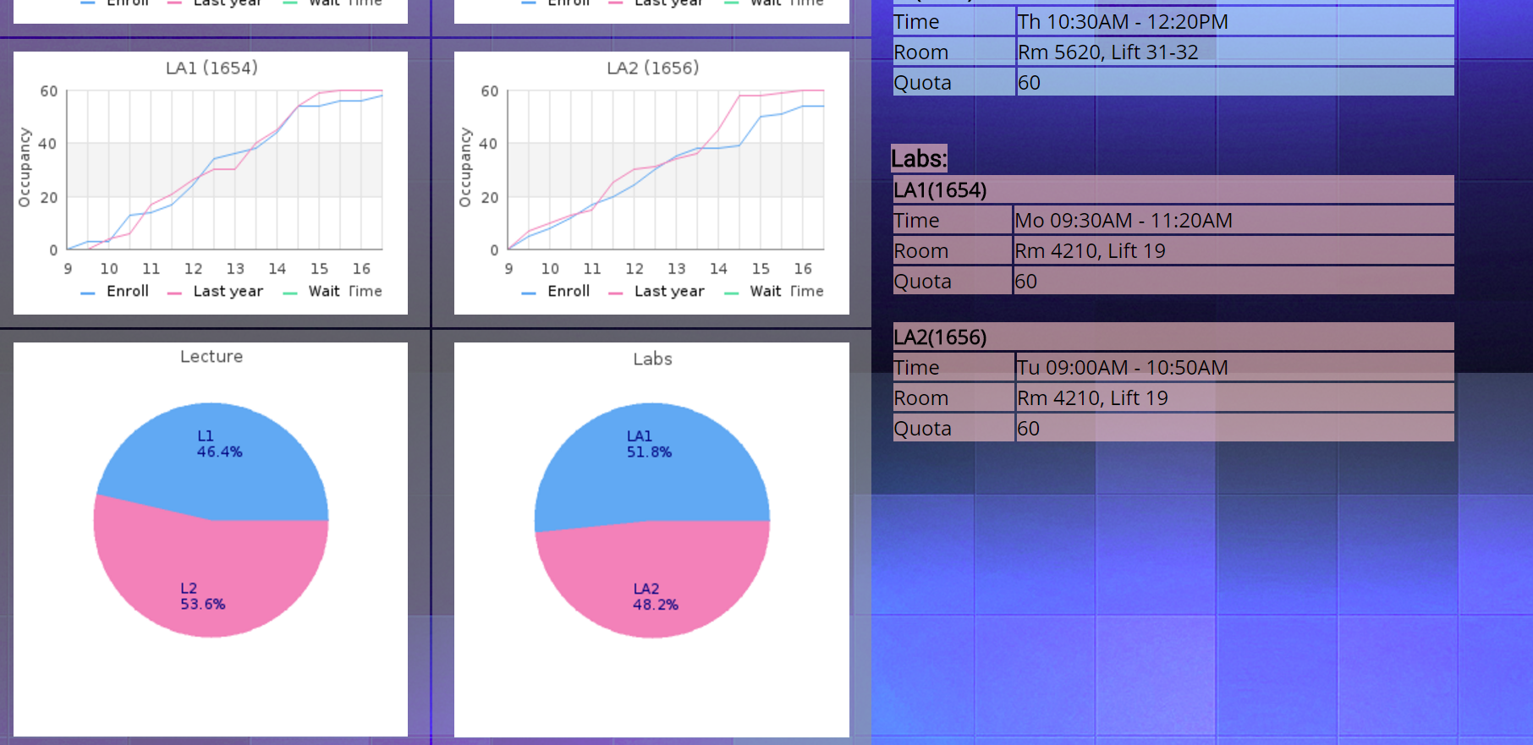
Feature – Plotting Graphs
Generate graphs from obtained data
Combine different sets of data for most intuitive result

Slide 7

Challenges and Solutions
Data grabbing
regex
Too much cases to handle
Low efficiency
DOM library and FirePath
Well-made for html parsing
Easy and direct

Slide 8

Challenges and Solutions
Data Storage
MySQL? PostgreSQL?
Overkill!
SQLite
Rarely used in server side
We don’t do concurrent writing so its ok
Fast and Light!

Slide 9
Thank you! Have Luck in Course Enrollment

